Slide 1

BD Media Partners Centre
Video offer access guide

Slide 2


Accessing our Video Offer
BBC World Service English Video Offer: Our new English video content offer ranges from health to problem solving to food… This guide will show you step by step the different ways you can access our video content.
Ways to access our World Service Video offer via Media Partner Centre
Direct Link: https://wspartners.bbc.com/article/world-service-english-video-offer
From Home Page top carousel
From Home Page mid page specials
Using search bar with key words or programme brand name
From content catalogue
Ways to download World Service Video offer episodes
Programme information - Choose a programme brand.
Chose one of the latest episodes from the brand page or browse all episodes
Add to basket from episode teaser or from episode information page
How to download
01.12.18

Slide 3
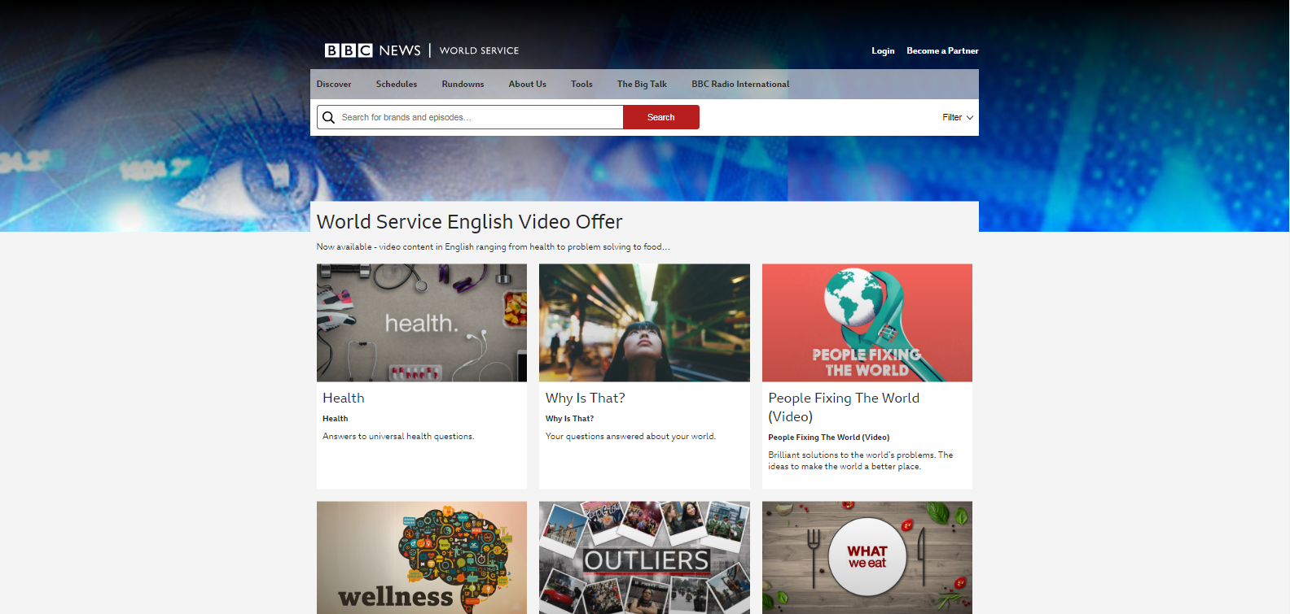
1. Direct Link
You can access our video offer directly by using this link https://wspartners.bbc.com/article/world-service-english-video-offer. Here you can explore our cluster page of all programme brands available.
Click in a programme brand to find out more information about that programme.
01.12.18

Slide 4
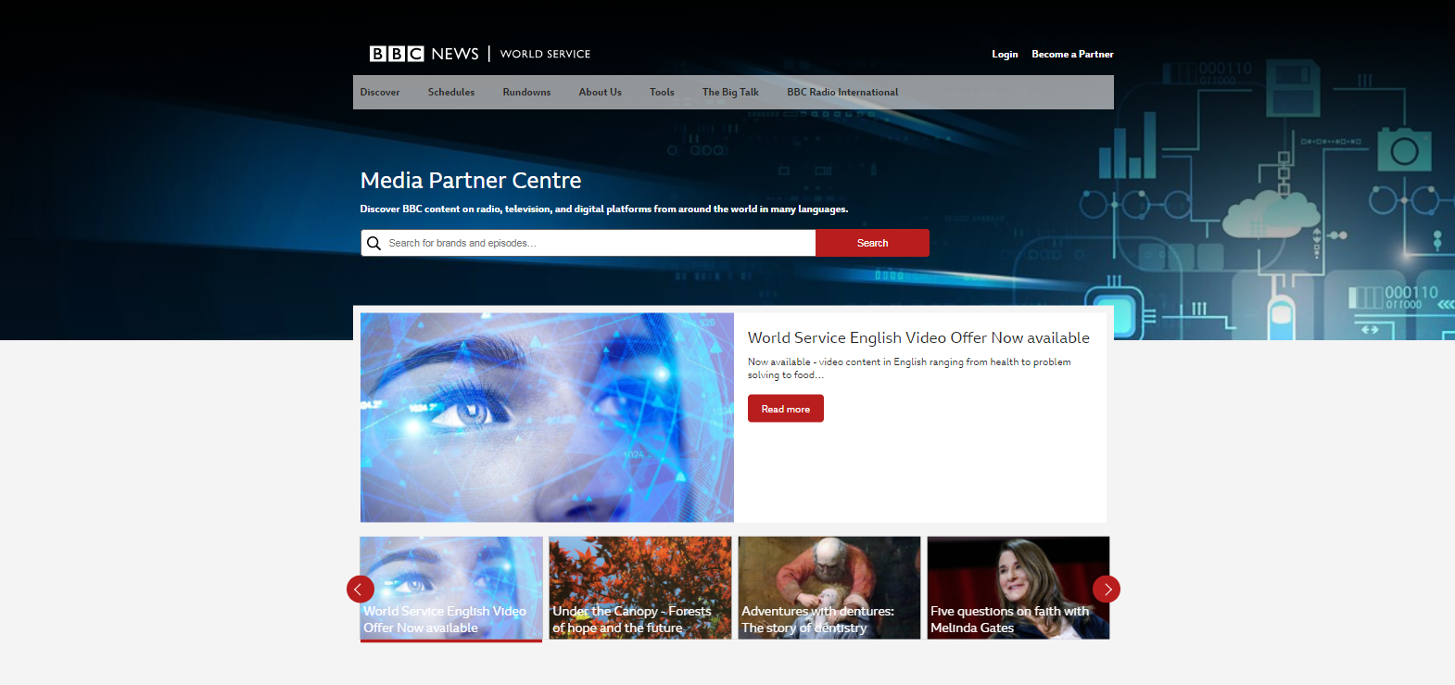
2. Home Page Carousel
You can browse the carousel using the arrows and select Read More for the video offer
01.12.18

Slide 5

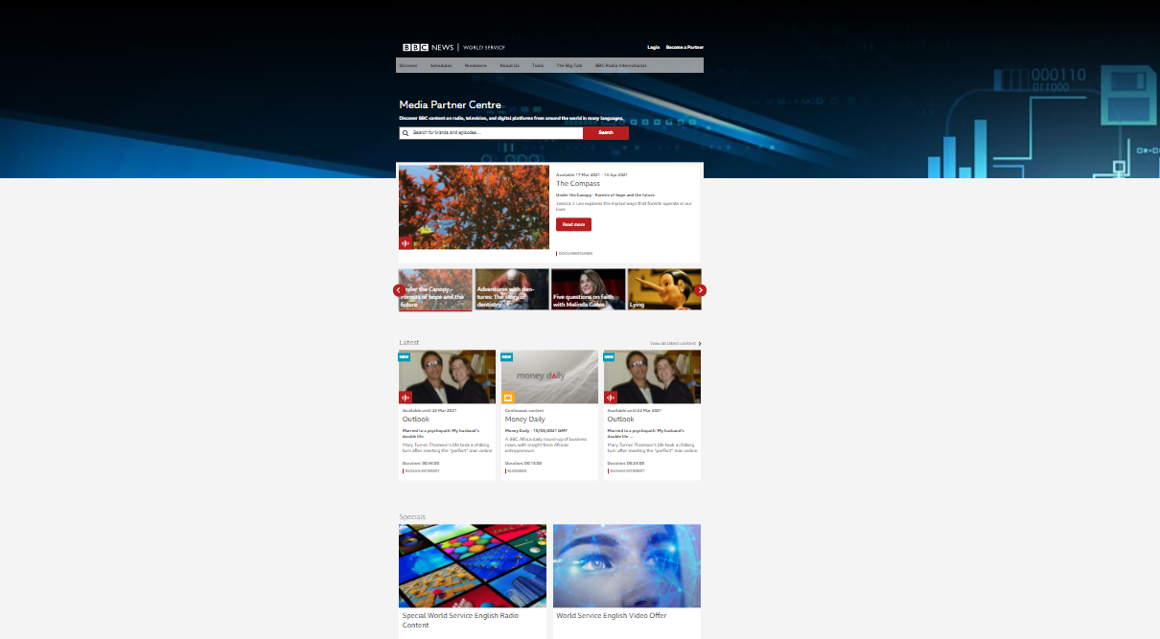
3. Home Page Specials
You can scroll down on the home page to select the video offer link via the Specials section
01.12.18

Slide 6
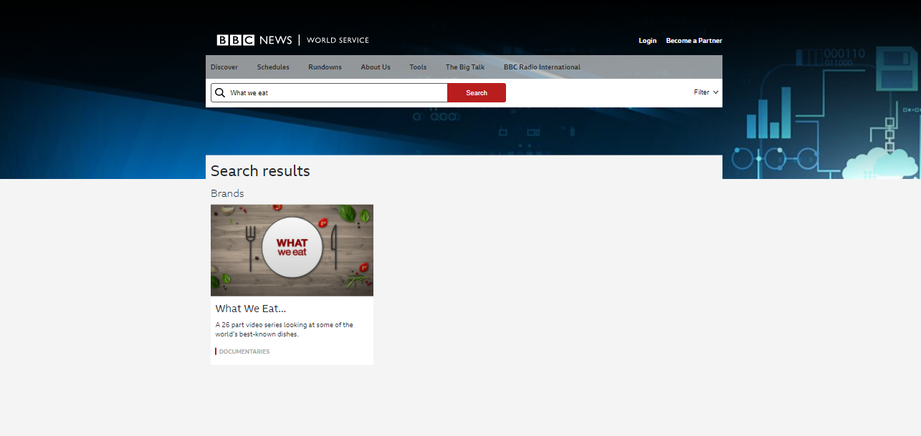
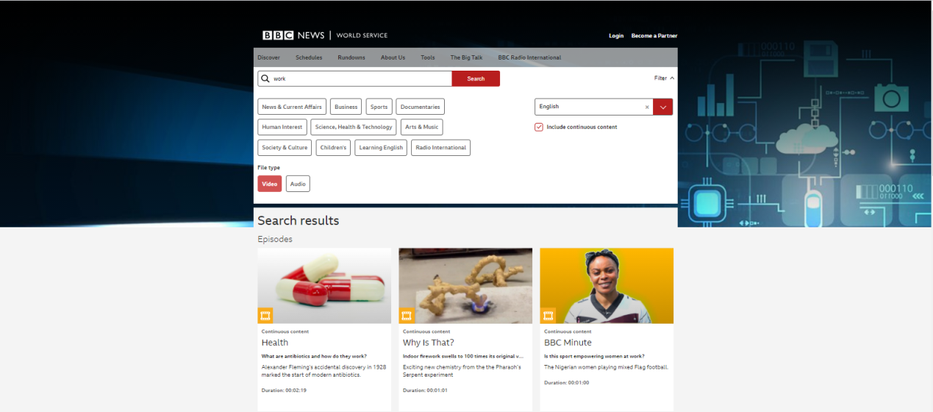
4. Search Bar
Or via our search bar
Type the programme brand name and click search .
Search for a key word and use the language and video filter to find a listing of episodes available.

Slide 7
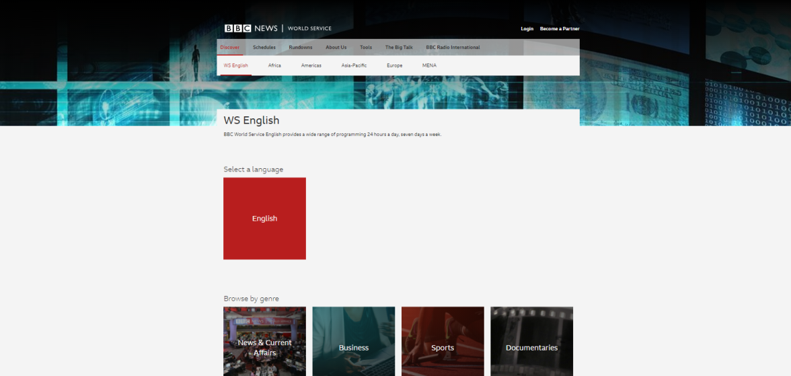
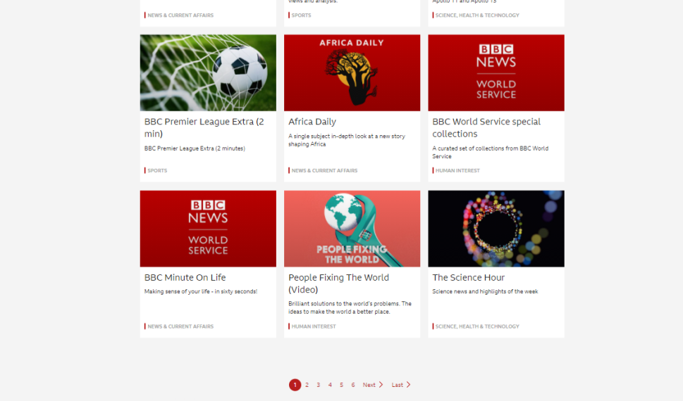
5. Catalogue Page
You can also search for video via the brand
Click on Discover via top navigation bar, and choose WS English.
Browse our programme brands and select for more information and choose available episodes to download.

Slide 8
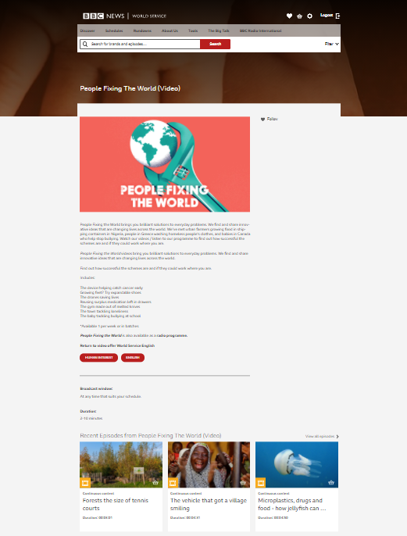
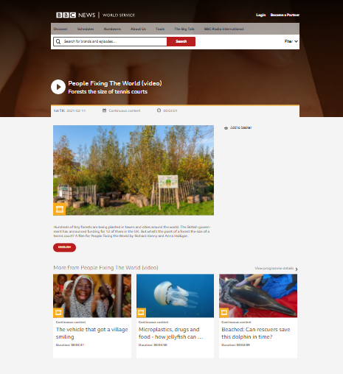
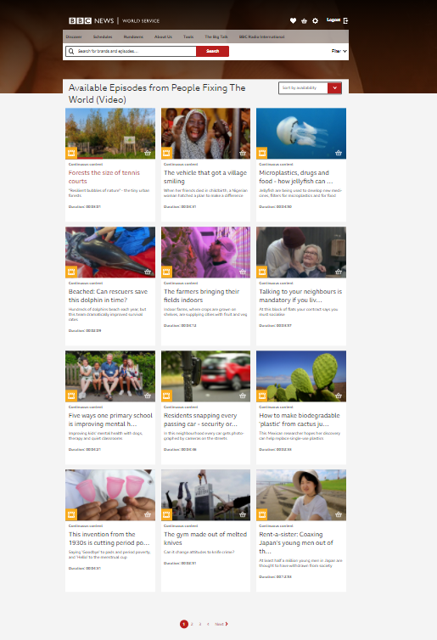
6-8.Programme Information
You can also find full episode information by clicking in the programme teaser.
All the information for a programme brand.
On this page you can find …
Add each item to the basket Or browse all episodes…

Slide 9
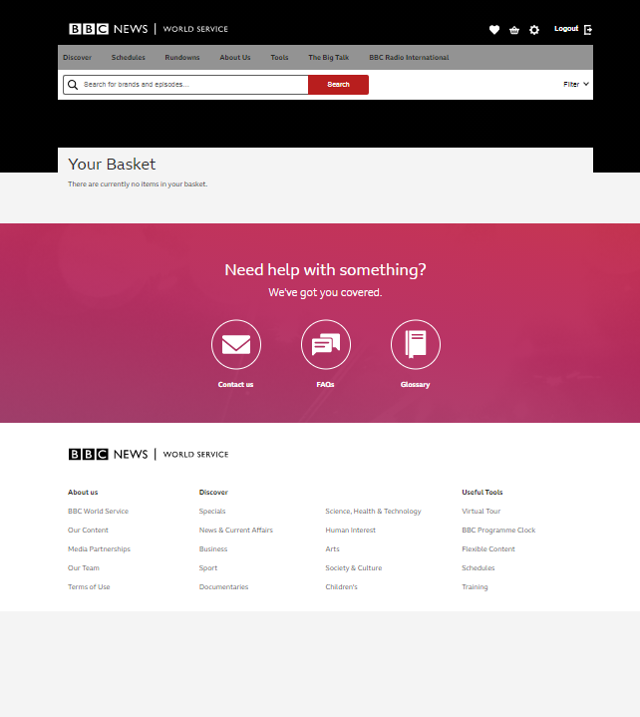
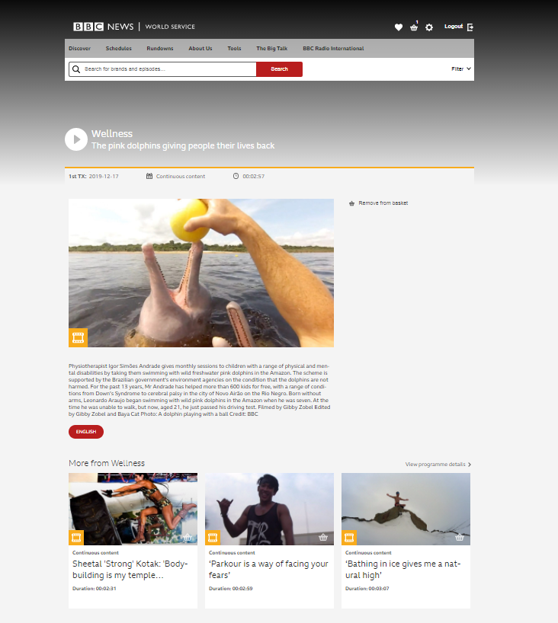
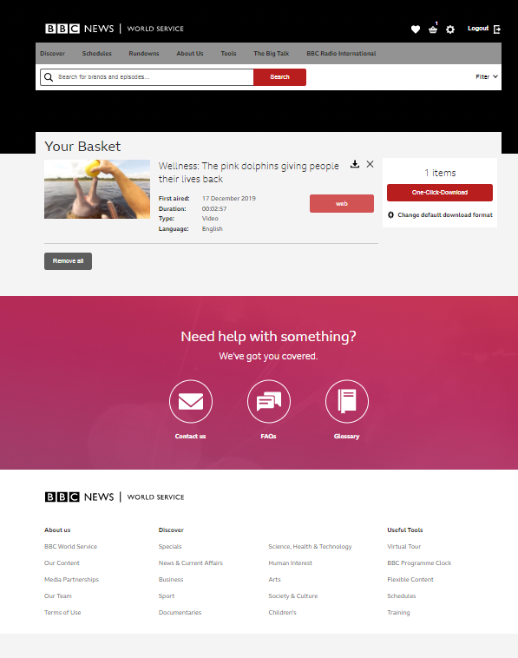
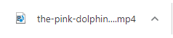
9. Downloads
Click on one click download to download all the item/items in your basket
Follow the steps below to download
The item will then appear in your basket at the top
The item/items will then disappear from your basket and you will receive a pop up in the bottom left hand corner of your screen with the download
You can add items to your basket two different ways. By clicking add to basket or via clicking the shopping cart image.

